Slide 1
Bank Database
By –Tushar pundir

Slide 2
INTRODUCTION
This SQL project involves simulating bank transaction system by creating pseudo accounts for colleagues and designing a structural database.
Key operations were creating multiple tables which stores diverse set of data such as account detail, customer profile, etc.
Relations were established between the data using primary and foreign key to ensure data integrity. The queries were performed to analyze transaction pattern, customer summaries, etc. This project demonstrated database and efficient data handling

Slide 3
Creating the Database
Before creating the tables, you need to create a database.
Query Used:
CREATE DATABASE bank;
USE bank;

Slide 4
Creating the account_info Table
Query Used:
CREATE TABLE account_info ( account_number VARCHAR(20) PRIMARY KEY, customer_id VARCHAR(10), account_type VARCHAR(20), balance DECIMAL(15, 2), ifsc_code VARCHAR(15), FOREIGN KEY (customer_id) REFERENCES customers(customer_id),
FOREIGN KEY (ifsc_code) REFERENCES
bank_info(ifsc_code));

Slide 5
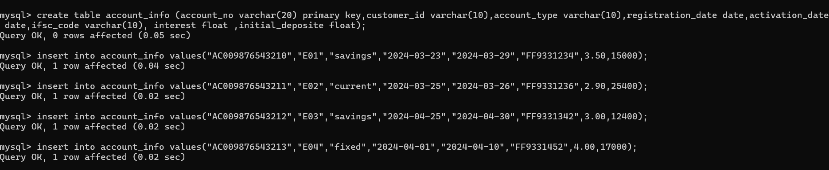
here is the entry query that I performed to create this table named account_info
Then there is the insert query which I used to enter data into the given table

Slide 6
Using alter table add constraint command to declare ifsc_code as foreign key that references on bank_info

Slide 7
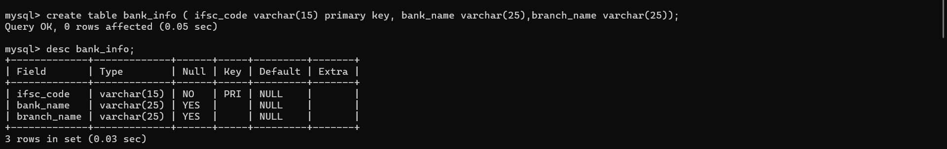
Creating the bank_info Table
Query Used:
CREATE TABLE bank_info ( ifsc_code VARCHAR(15) PRIMARY KEY, bank_name VARCHAR(25), branch_name VARCHAR(25));

Slide 8

Insert command to enter the data in bank_info table

Slide 9
Creating the customers Table
Query Used:
CREATE TABLE customers (customer_id VARCHAR(10) PRIMARY KEY, customer_name VARCHAR(50), dob DATE, guardian_name VARCHAR(50), address VARCHAR(100), phone_number VARCHAR(15), email VARCHAR(50), gender CHAR(1), marital_status VARCHAR(10), id_proof VARCHAR(20), nationality VARCHAR(30));

Slide 10
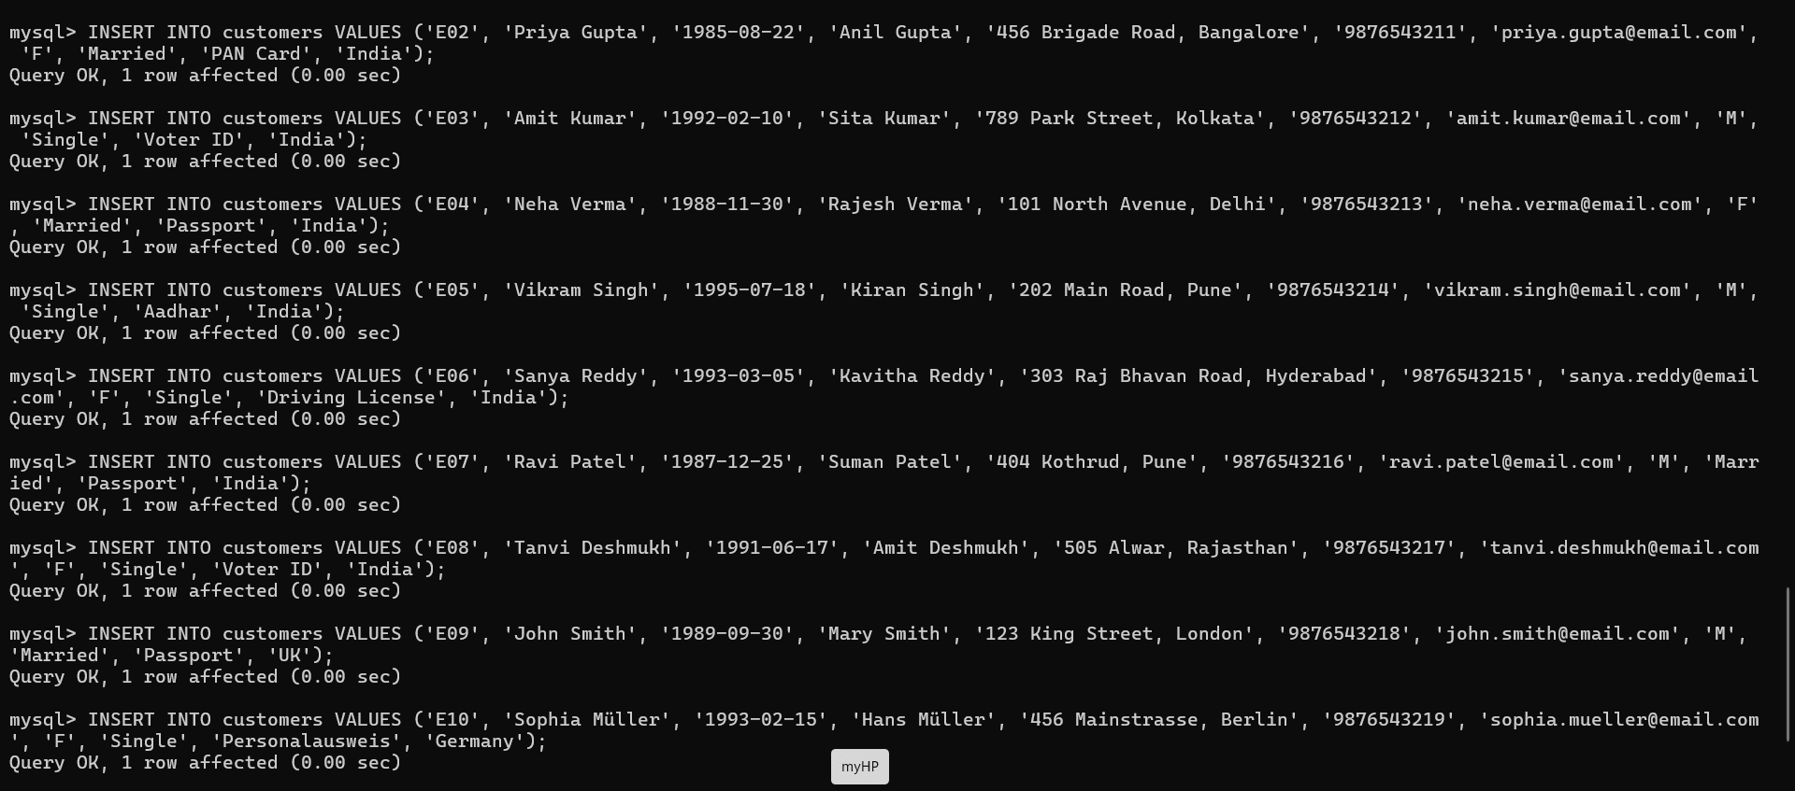
Insert command to enter the data of customers in to the table

Slide 11

Creating c_r_t table
Query used:
CREATE TABLE C_R_T ( employee_id VARCHAR(10) NOT NULL PRIMARY KEY, reference_acc_name VARCHAR(20), reference_acc_no VARCHAR(20), customer_id VARCHAR(20), reference_acc_address VARCHAR(50), FOREIGN KEY (customer_id) REFERENCES customers(customer_id) );

Slide 12

Insert command to enter the data in c_r_t table

Slide 13
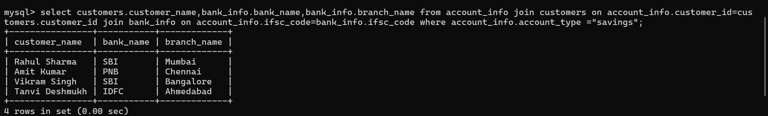
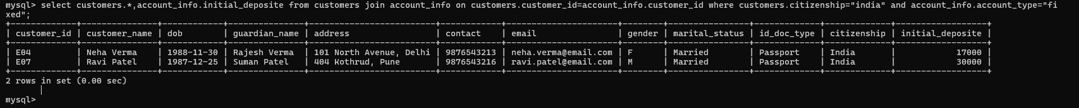
Query performed to retrieve the required date from the bank database
Query no1: write a query to show customer name,bank name,branch name where account type is saving.
Query no2: write a query to show the customers details along with the fixed deposite of a customers who have Indian citizenship and have fixed account .

Slide 14
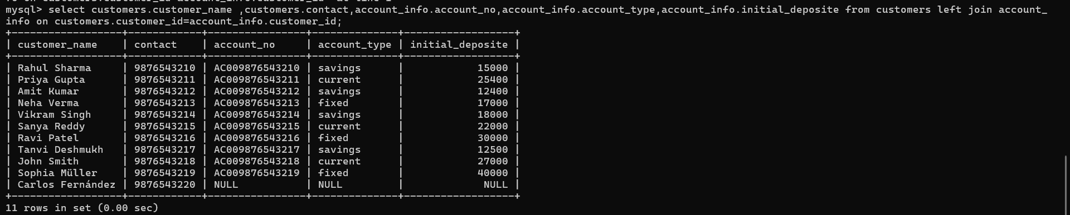
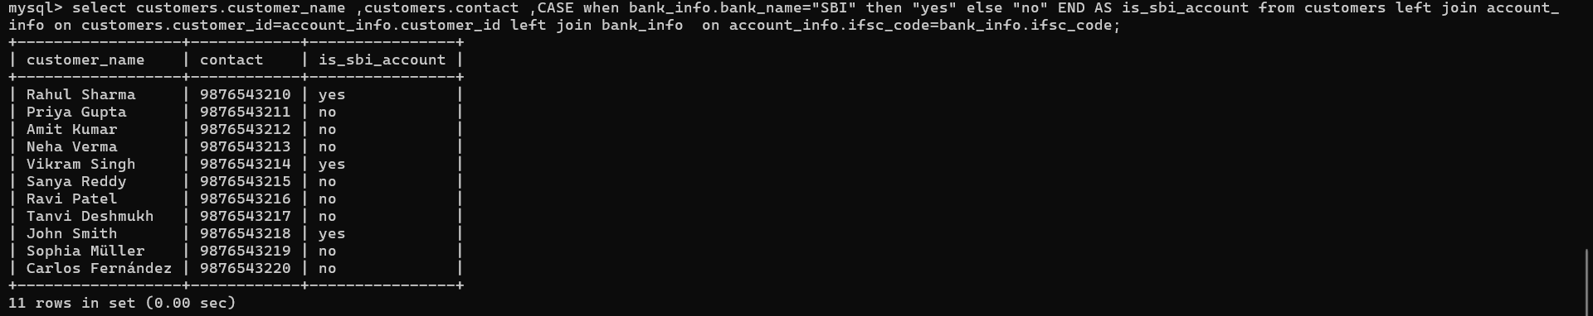
Query no 3: write query to show all the customers along with their account details even if they don’t have any associated account
Query no 4: write a query to retrieve the customers detail with the bank name=“sbi” get another column declaring whether the account is sbi or not

Slide 15
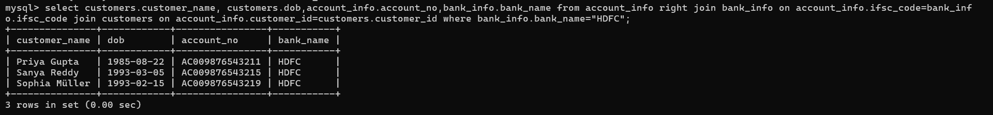
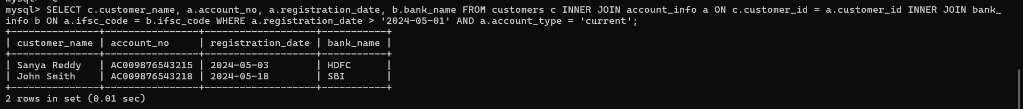
Query no 5: write a query to retrive the customers detail and accountdetails along with bank name where the bank name is “hdfc”.
Query no 6: write a query to fetch customer name ,account name registration date ,bank name condition involving customers’s who have current account and registration date must be after may 1,2024.

Slide 16
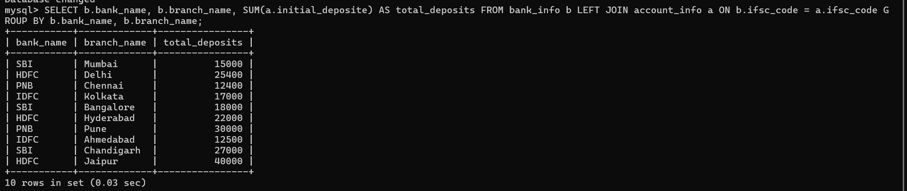
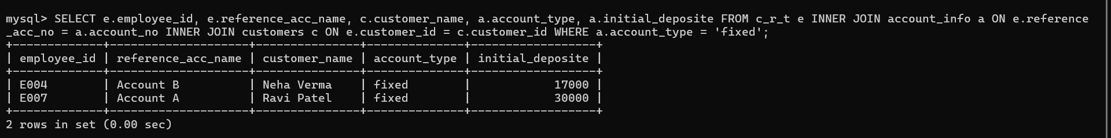
Query no 7: write a sql query to retrive following information branch name , total deposite .grouped by branch name and also calculate initial deposite associated with each branch .
Query no8:Write a query to fetch details related to employee and customers who are associated with fixed deposite.

